Slide 1
Identifying Real/Fake COVID-19 Health Information
Angel He
Edmund Lam
Melissa Feeney
Sharlene Chen

Slide 2
Agenda
1
Dataset Overview
2
Feature Engineering
3
Predicting Claim Validity with Topics and Engagements
4
Predicting Validity of News with Keywords and Sources
5
Conclusion

Slide 3
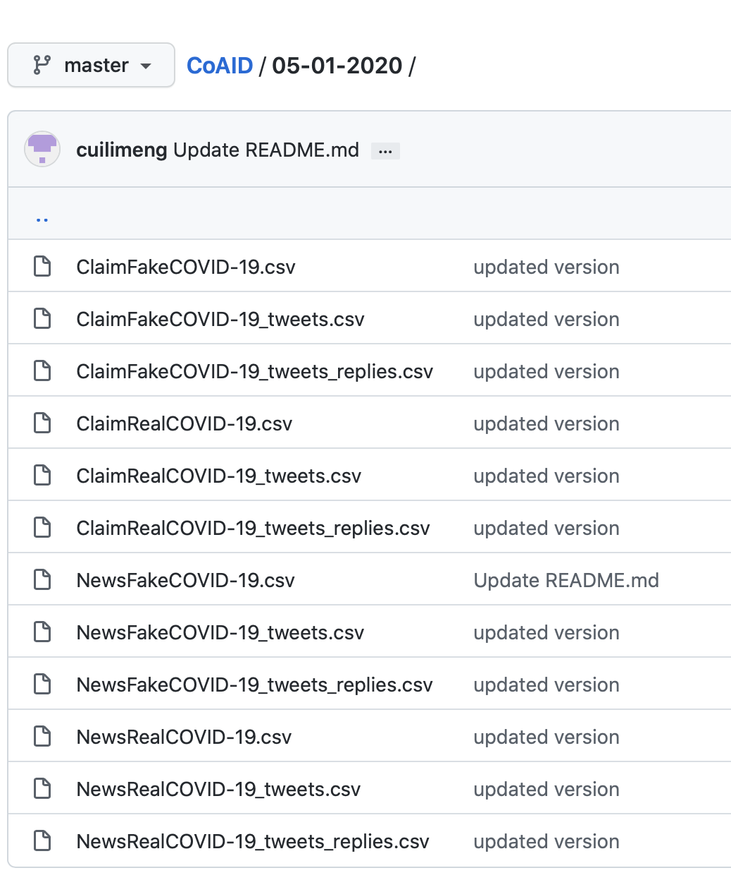
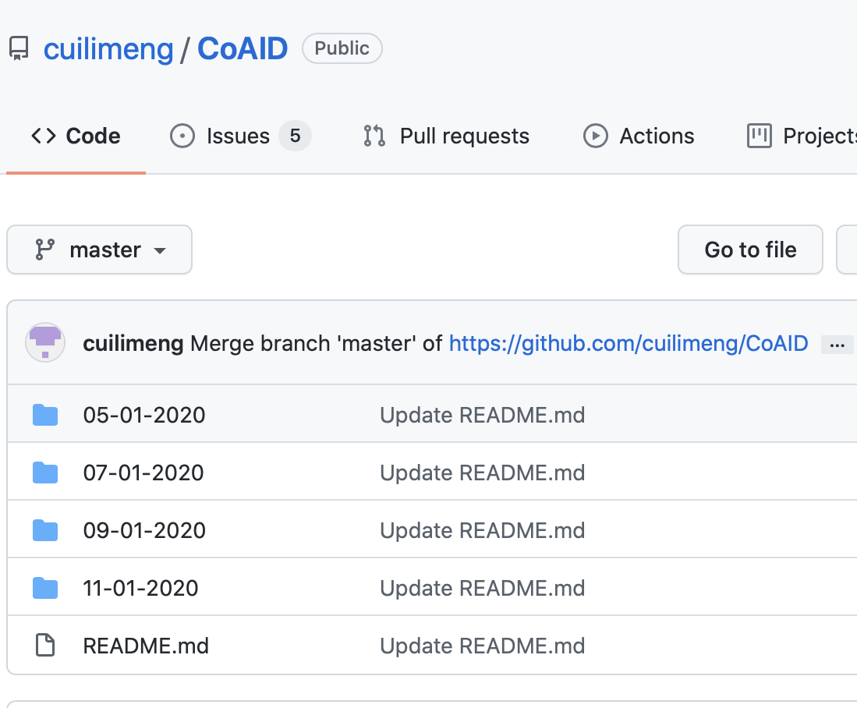
CoAID Dataset - Overview

Slide 4
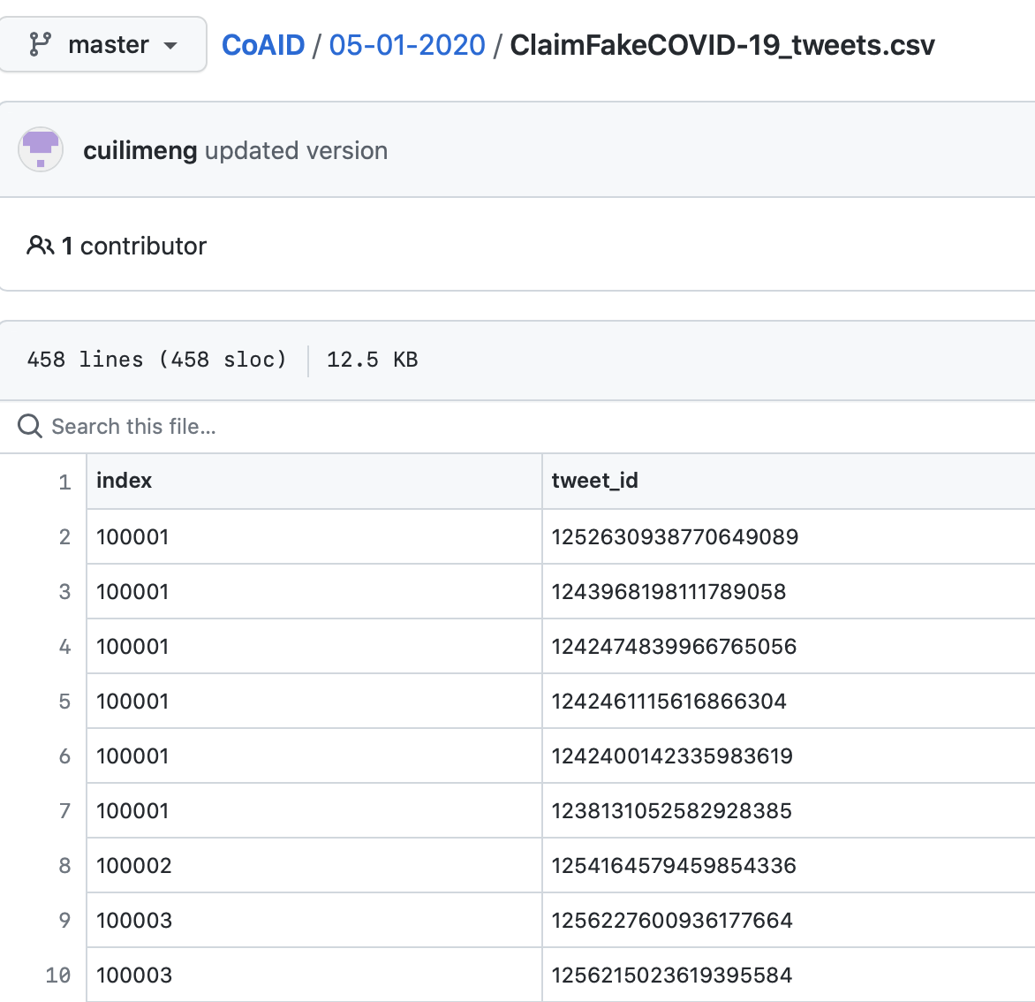
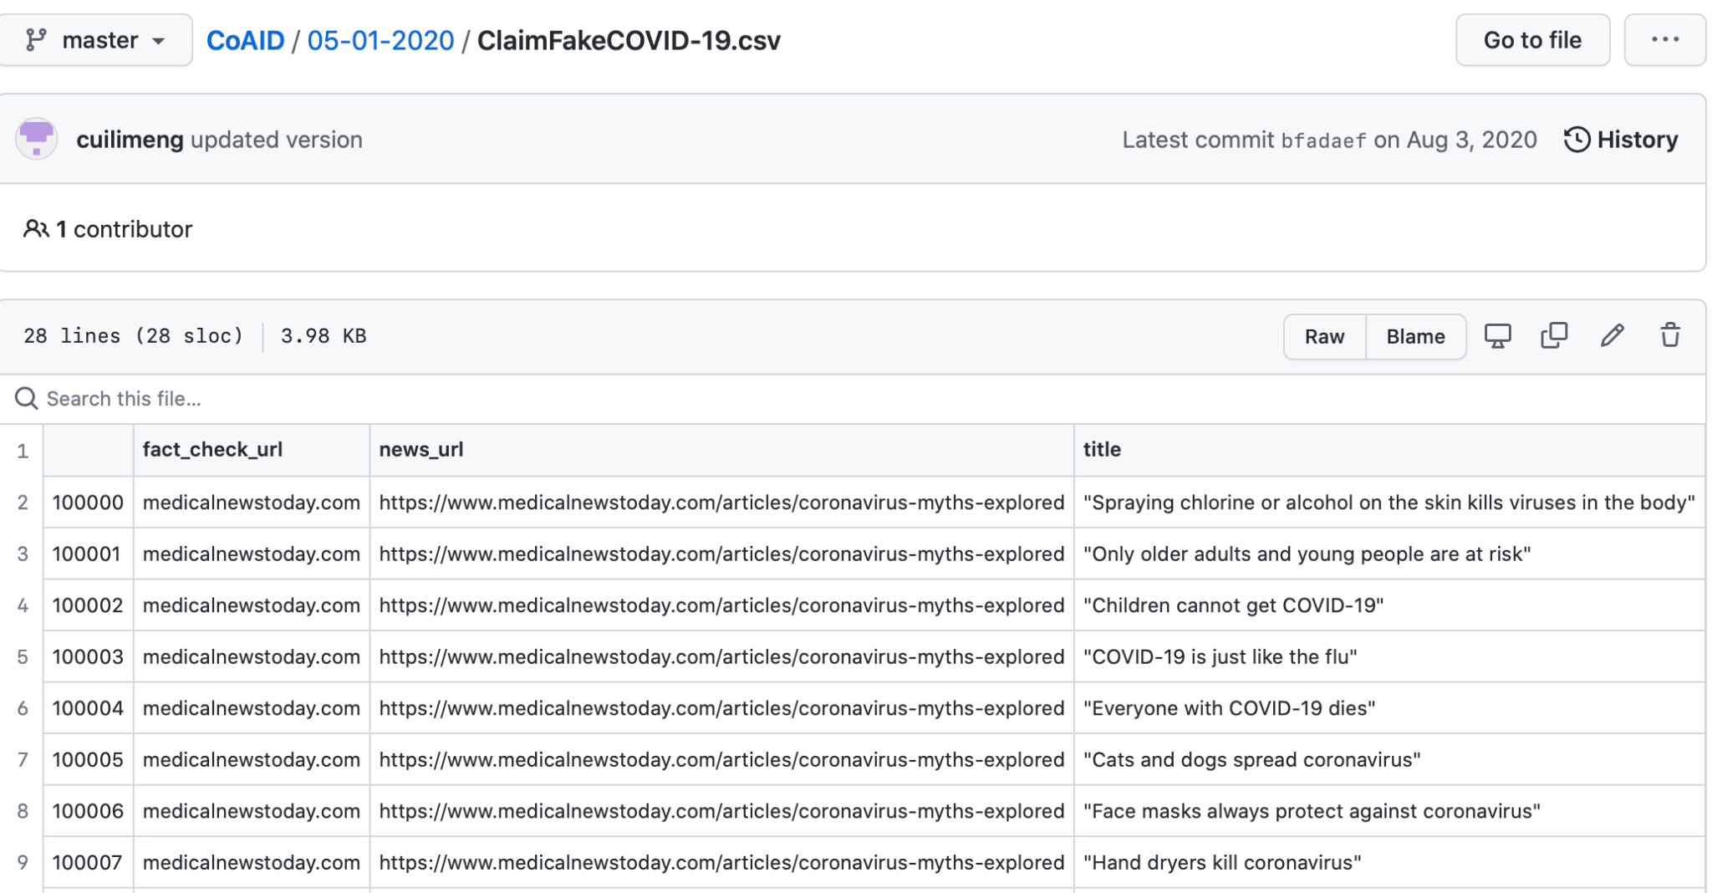
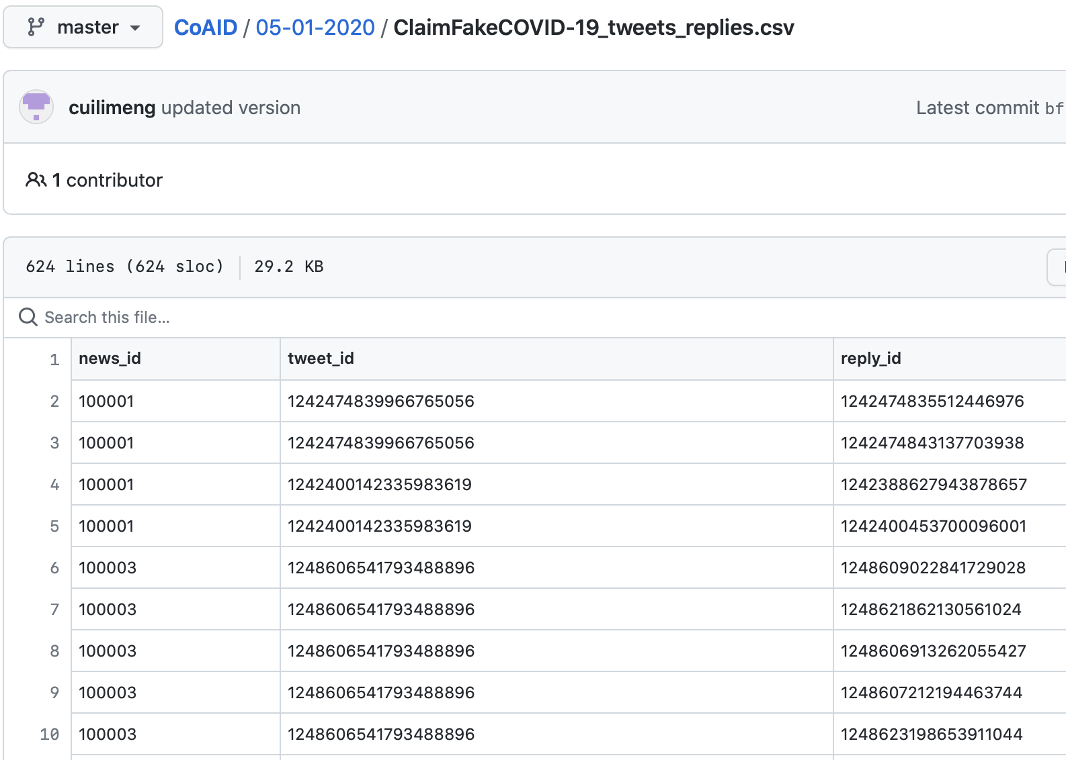
CoAID Dataset - Claims

Slide 5
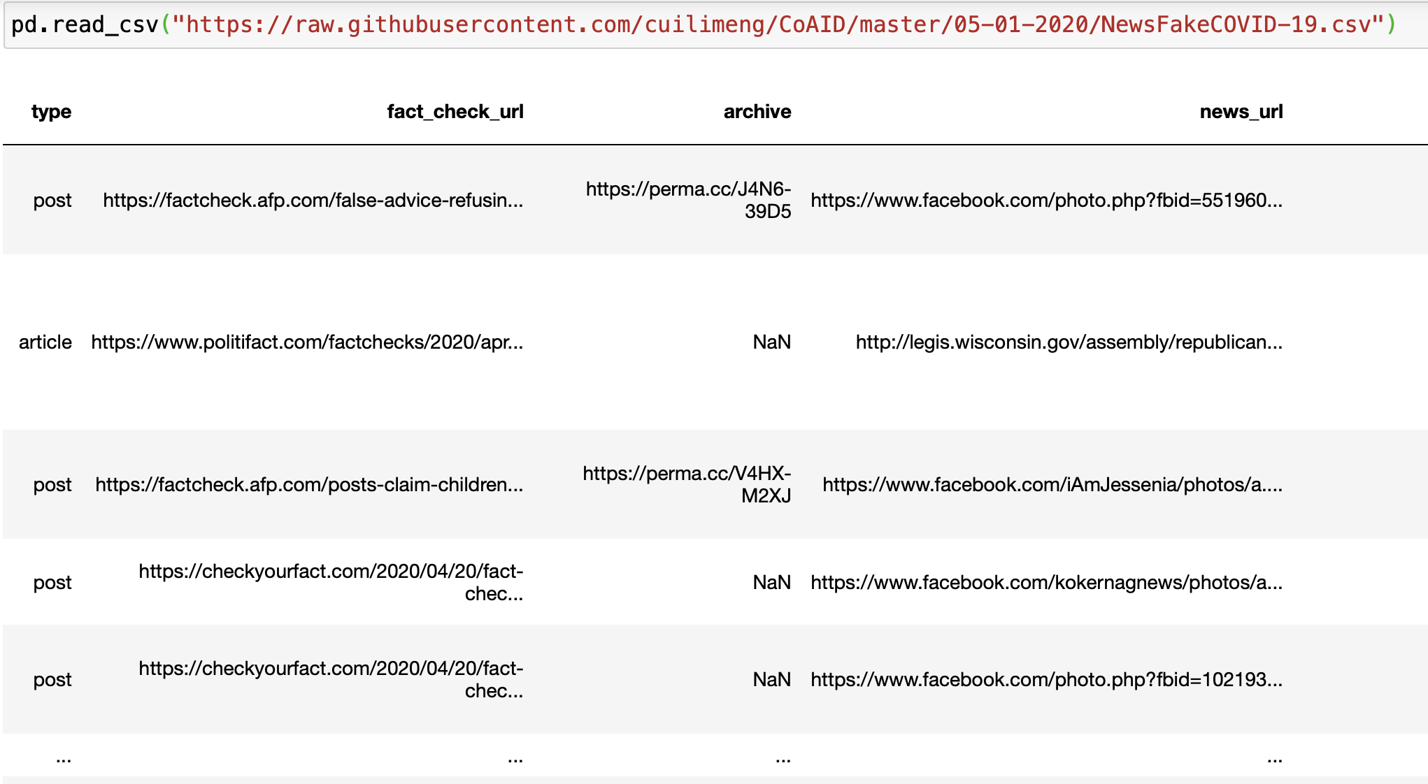
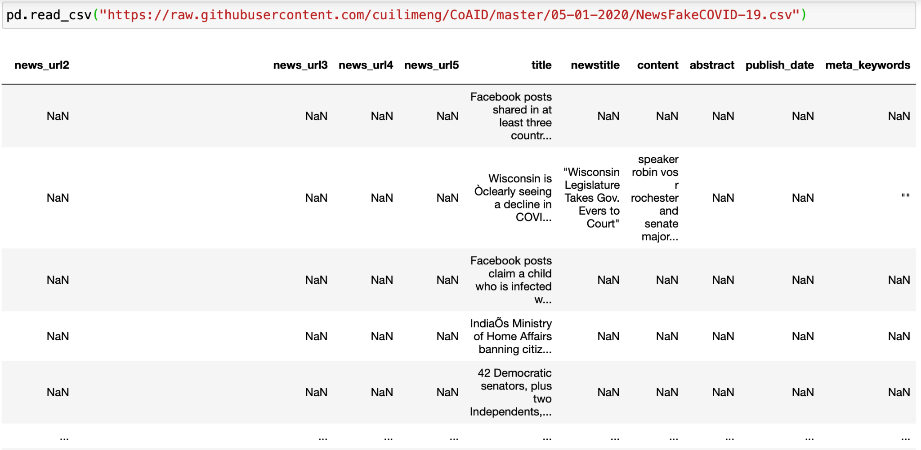
CoAID Dataset - News articles
Same structure for news tweets and tweet replies

Slide 6



Feature Engineering
Engagement
Claim Topic Analysis
Source
News Title
Find predictive words in news titles through their distributions in real and fake news datasets
One Hot Encoding for select predictive words for use in ML
Tweet counts
Reply counts
Website Name
Type of source (article, post)
Social Media or not
Get topics of each short claim by vectorizing the text and applying CorEx topic modeling
Tweet Counts + Reply Counts
= User Engagement

Slide 7
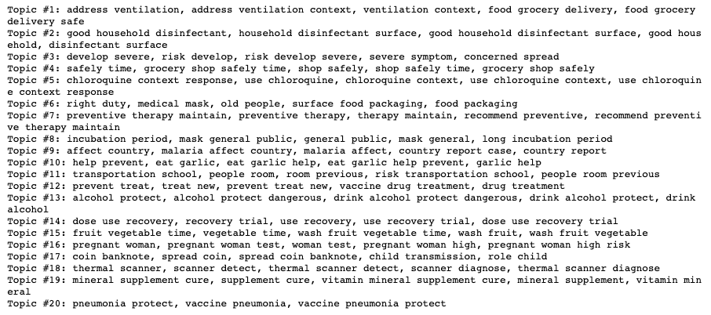
Claims Topics
CorEx topic modeling was used to detect recurrent themes in the claims data, and the top words within each topic can help to characterize the topics
Topic #2: related to household cleaning and disinfection
Topic #1: related to ventilation
Topic #10: related to whether or not garlic might treat/prevent COVID-19
Topic #5: related to the use of chloroquine to treat COVID-19
Topic #15: related to the need to wash purchased produce to eliminate potential COVID-19 remnants
Topic #19: related to vitamin/mineral supplements to treat/prevent COVID-19
Topic #16: related to pregnant women and their COVID-19 risk
Topic #20: related to the pneumonia vaccine and its potential impact against covid

Slide 8
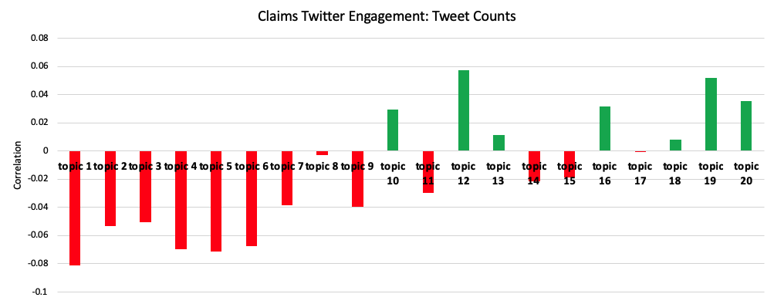
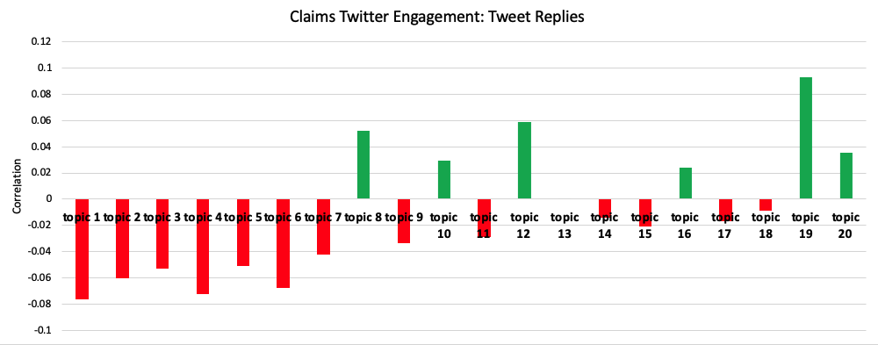
Claims Topics and Twitter Engagement
Correlating claims’ Twitter engagement through tweets and replies with the claims’ probabilities of being associated with the topics can help to understand which topics may drive more engagement
In general, the patterns in tweet counts and replies for claims behave similarly
The more likely that topics 1 through 7 are mentioned in a claim, the less likely the claim will earn high engagement
Claims that feature topic 19, which discusses vitamin and mineral supplements to treat/prevent COVID-19, earns high engagement

Slide 9
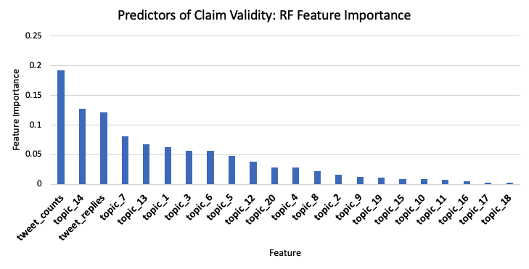

Topics and Engagement as Indicators of Claim Validity
The topics in the claims found by CorEx can be used along with Twitter engagement to predict claim validity with reasonable model performance:
According to the topic explanations on the previous slide, in addition to the tweet and reply counts that a claim receives, claims that mention recovery drug trials, preventative therapies, and alcohol are most dominant in determining claim validity

Slide 10
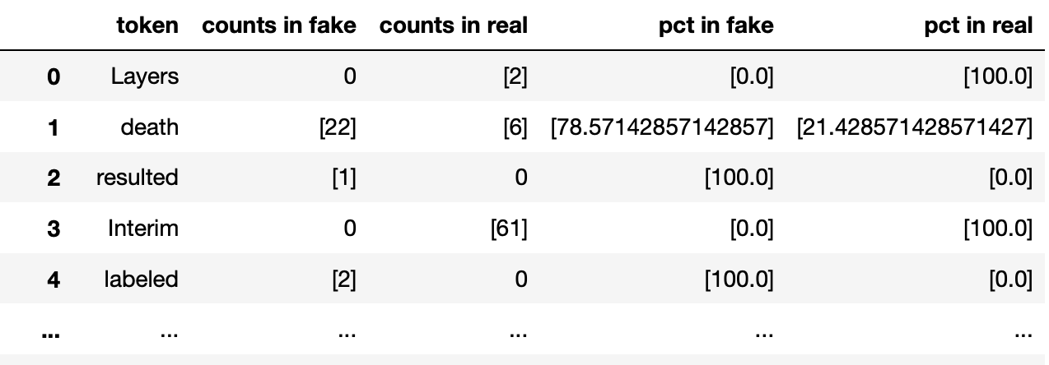
Keywords in News Titles
Token: individual word that appears in news titles
Counts in fake: number of times the word appears in fake news dataset
Counts in real: number of times the word appears in real news dataset
Pct in fake: counts in fake / (counts in fake + counts in real)
Pct in real: counts in real / (counts in fake + counts in real)

Slide 11
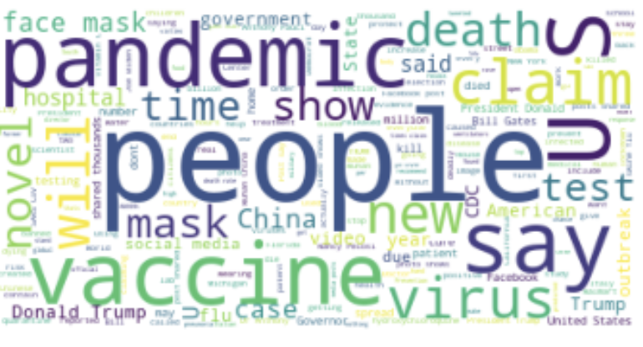
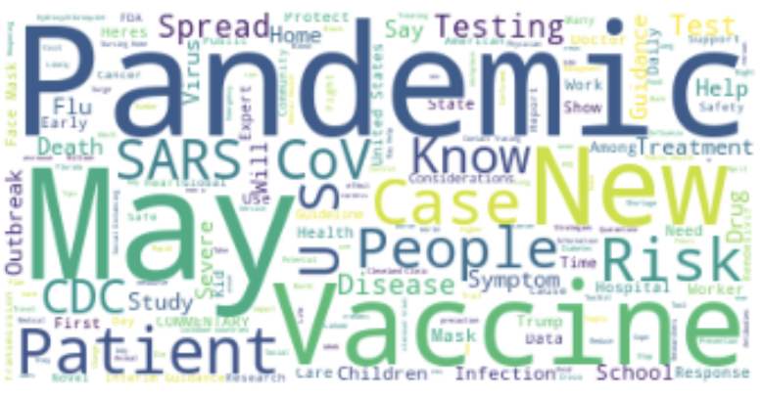
Keywords in News Titles
← Frequently-
appearing words in fake news titles
Frequently-
appearing words in real news titles
Lots of overlap, need a better way to find important words that help distinguish between real and fake news

Slide 12
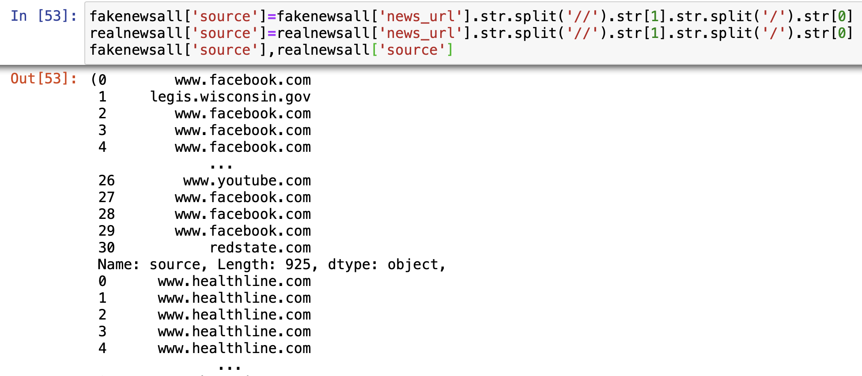
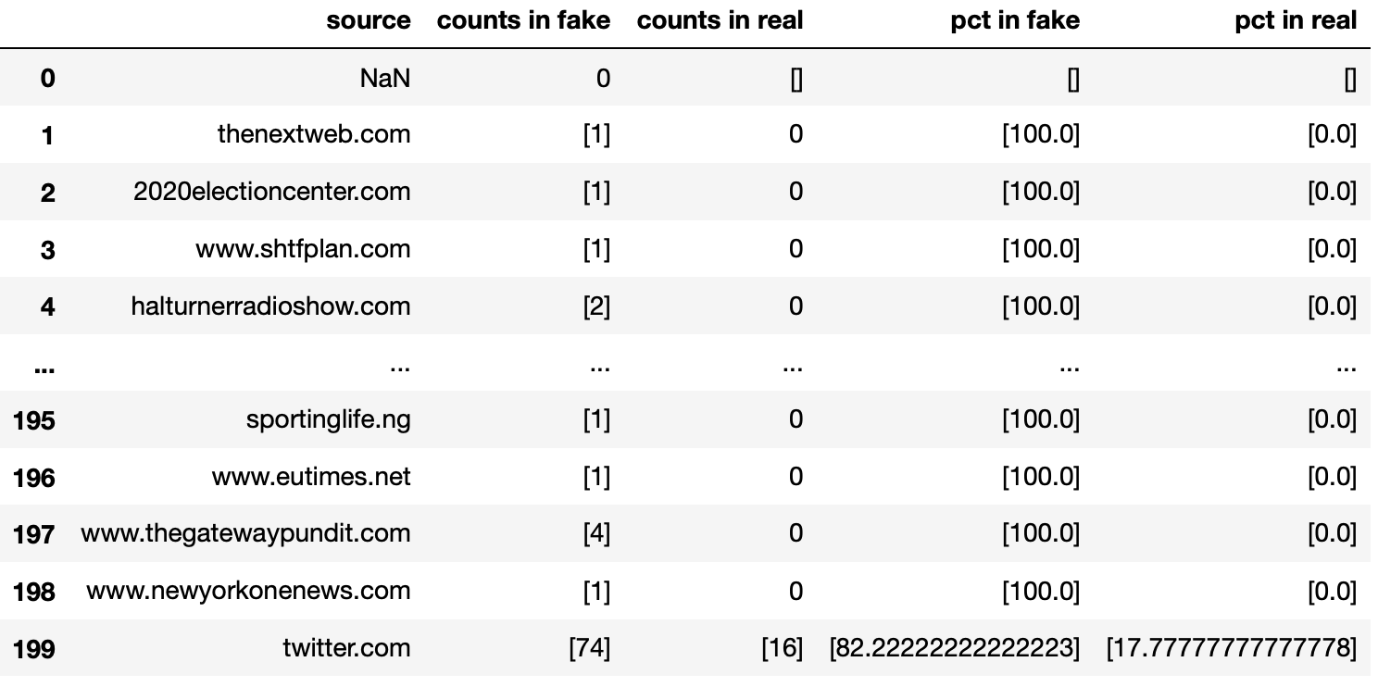
Source of News Articles

Slide 13
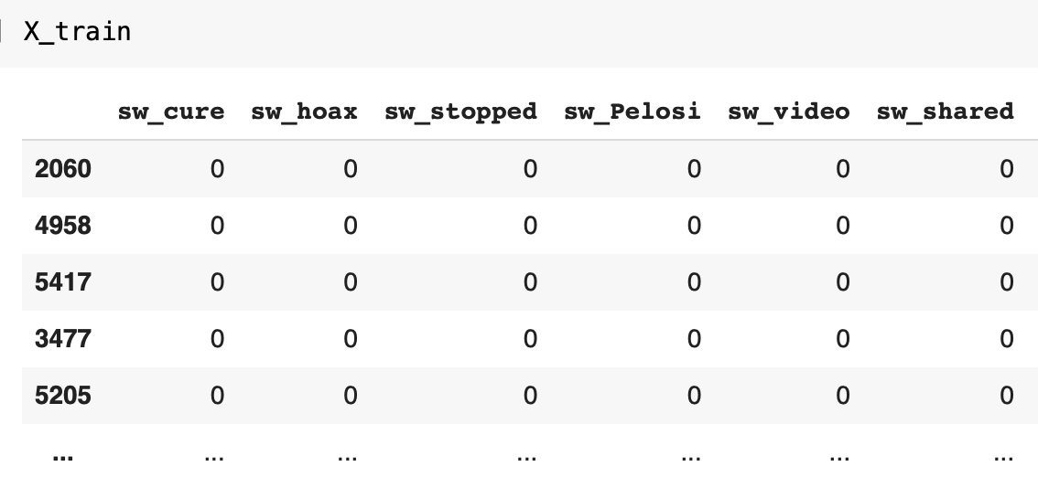
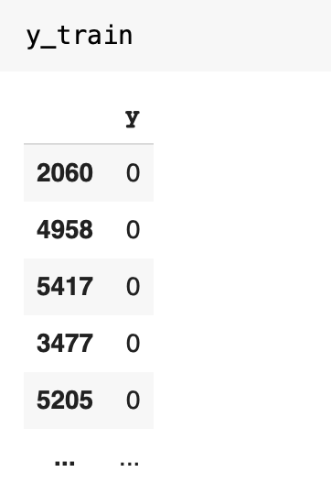
Models
y variable: 1 if news is fake, 0 if news is real
Features: select keywords and news sources based on their distributions among real and fake datasets (ie. pct in fake = 100 and counts in fake >= 3), in binary format
Basic logistic regression and random forest models with 75/25 train test split
...

Slide 14
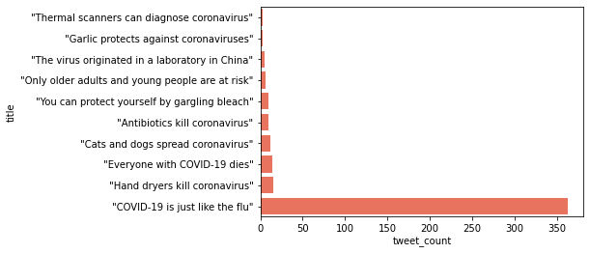
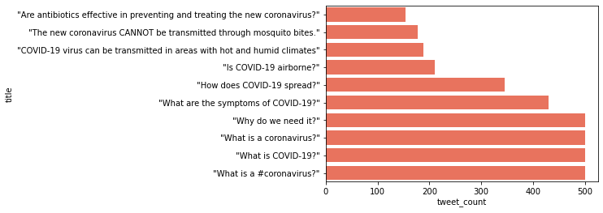
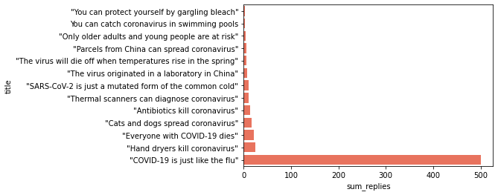
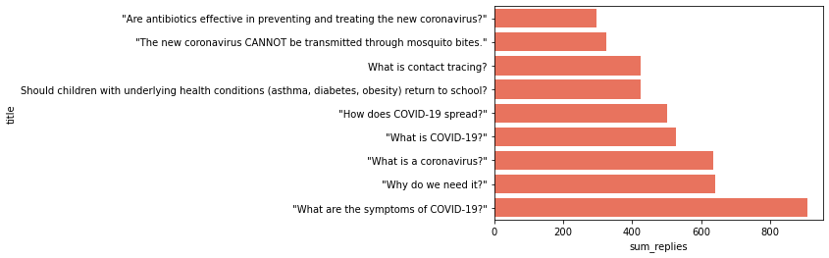
Imbalanced Data
Fake Real
Tweets
Replies
adding precisions, recall scores and F1 scores as metrics to compensate for this

Slide 15
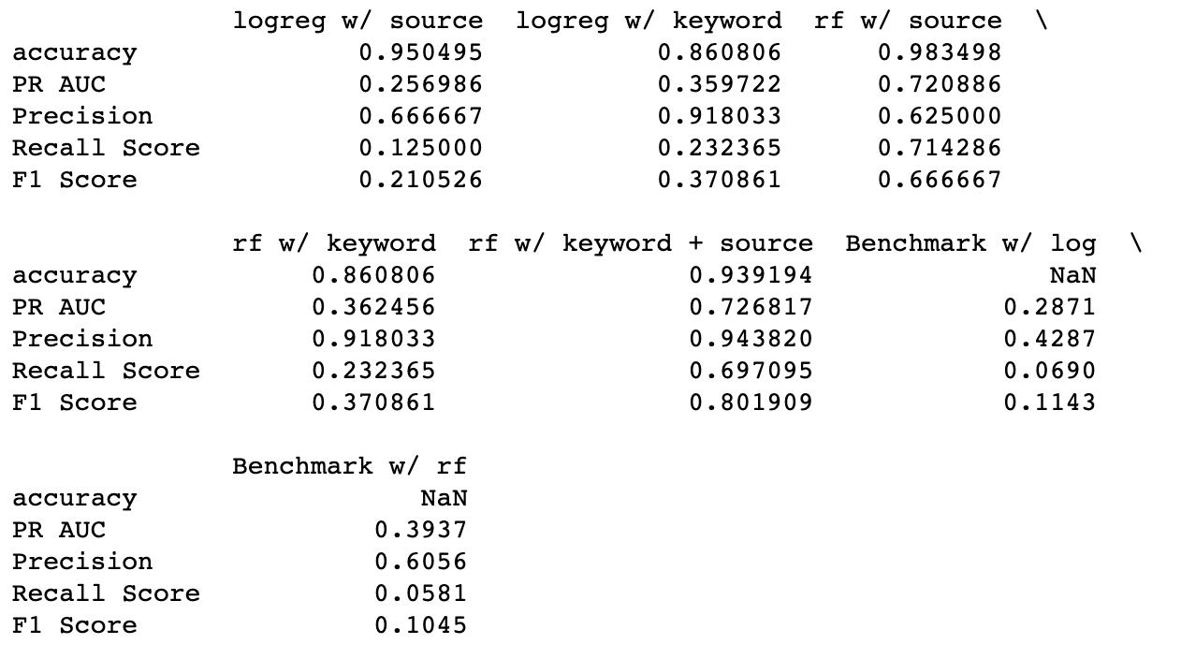
Performance
2
1
1
BEST: Random Forest Model with Source and Keyword
High accuracy without sacrificing precision, recall and F1 score
Second: Random Forest with Source only
2
Benchmark performances from CoAID: COVID-19 Healthcare Misinformation Dataset, arXiv:2006.00885 [cs.SI]

Slide 16
Conclusion
Some of the most prevalent themes within claims discuss preventative measures against COVID-19, and the topics in claims can be used along with Twitter engagement to predict claim validity
Keywords and sources are big indicators of realness and fakeness of news articles
Future steps:
Experiment with more keyword and source combinations, and more models
Tune and optimize models
Train and test on more diverse and comprehensive dataset to improve the generalizability of models
Obtain data from Twitter to further analyze sentiment on Twitter
Notes:
(in the current dataset, source of a news article can entirely determine the realness or fakeness, but that’s not likely in the real world)

Slide 17
Thank you!

